Slide 1
GCBASIC
PIC18FxxQ35chip Family
Part 18 – The GCBASIC tool chain

Slide 2
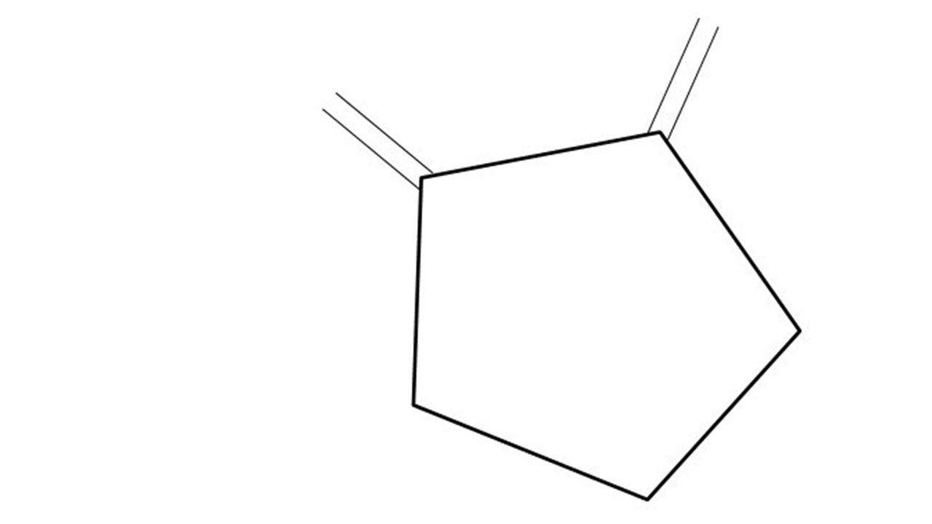
GCBASIC
PIC18FxxQ35chip Family
Part 18 – The GCBASIC tool chain

Slide 3
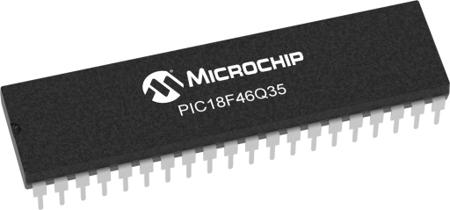
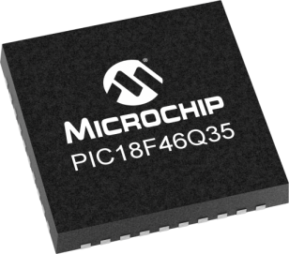
GCBASIC
Like and subscribe!

Slide 4
PIC18FxxQ35
PIC18FxxQ35 is a high performance PIC18
  Digital and analog peripherals for flexible embedded control
  10-bit ADC for accurate analog signal conversion
  Multiple communication interfaces including UART (serial), I²C, and SPI
  PWM modules with CCP and 16-bit resolution for precise timing and motor control
  Configurable Logic Cells (CLCs) for custom hardware-level logic without external components
  Integrated op amps for onboard analog signal conditioning and amplification
The PIC18FxxQ35 offers 28, 40 and 44-pin products in small footprint packages to support customers in a wide variety of applications.

Slide 5
Videos...
Install the hardware and make the board work – make LEDs work
Make four LEDs flash in a sequence
Set the LEDs to represent the value of ADC
Sequence the LEDs with a delay using the value of ADC
Using an input to set the state of the LEDs
Using the reset switch
Using the switch, ADC – make the LEDs flash in a sequence with reverse
Using the serial to display values
Using the timer0 overflow, 8bit timer, 16bit timer to flash the LEDs
Using EEProm – showing values on the serial terminal, and more constants insights
Using I2C with serial to discover I2C devices
Using an I2C GCLD display
Using a SPI GCLD display
Using PWM, many ways, to dim the LEDS
Using Millis and Interrupts
Using storage within the chip – Progmem, SAF memory, EEPROM and DATA blocks
Using CLC
The GCBASIC tool chain
Assembly , alternatives assemblers and MPLAB-X
Summary

Slide 6
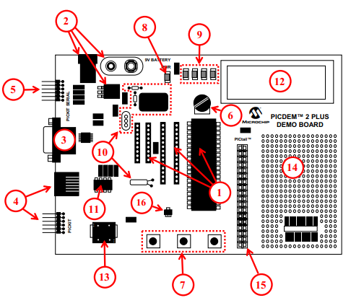
PICDEM 2 Plus Demonstration
Board
1. 18-, 28- and 40-pin DIP sockets
(although three sockets are provided, only one device may be used at a time)
2. On-board, +5V regulator for direct input from 9V, 100 mA AC/DC wall adapter or 9V battery, or hooks for a +5V, 100 mA regulated DC supply
3. RS-232 socket and associated hardware for direct connection to an RS-232 interface
4. Programmer/debugger connectivity supporting MPLAB® ICD 3, MPLAB REAL ICE and PICkitPlus
5. PICkit Serial Connector for analysis of serial communications peripherals such as SPI or I2C™
6. 5 k pot for devices with analog inputs
7. Three push button switches for external stimulus and Reset
8. Power-on indicator LED
9. Four LEDs connected to PORTB
10. On-board external oscillators including:
a) Unpopulated DIP socket for canned crystal oscillator (Y2)
b) RC oscillator circuit (R4, C3)
c) Unpopulated holes for crystal connection (Y1)
d) 32.768 kHz crystal for Timer1 clock operation (Y3)
11. 32K x 8 Serial EEPROM
12. LCD display
13. Piezo buzzer
14. Prototype area for user hardware
15. Expansion Header for PICtail™ daughter card connectivity or user access to MCU pins
16. Microchip TC74 thermal sensor
Plus SPI GLCD
3A

Slide 7
GCBASIC Compiler
GCBASIC is an Open Source compiler for PIC, AVR and LGT microcontrollers
GCBASIC now supports the 18FxxQ35 chip family
GCBASIC is a cross platform with common code translation
GCBASIC Compiler

Slide 8
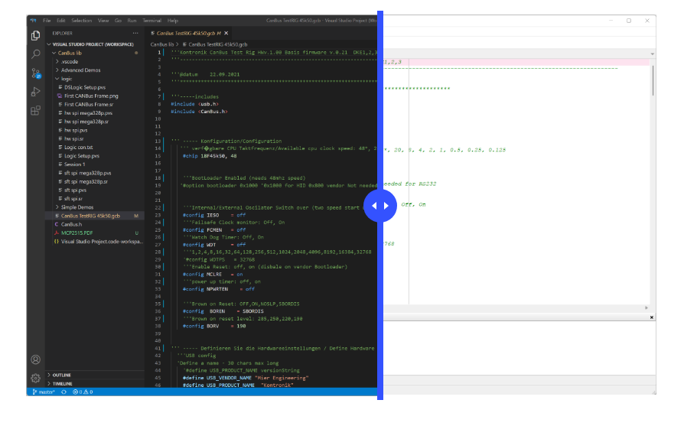
The GCBASIC Toolchain
PPSTool
AVRInfo
CLC
PicInfo
PSMC
GCBASIC IDE
GCBASIC Compiler
Programmers
GC Studio
Program Editor
Terminal
https://gcbasic.com/

Slide 9
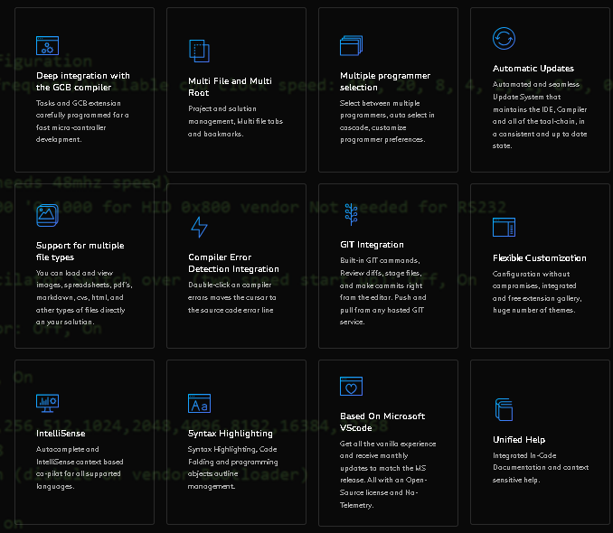

Slide 10
Tool chain
APPLICATION TITLE | CLASS | CORE | OS | SEEN | MAINTAINED
GCBASIC compiler | Compiler/Linker | Y | Windows, Linux, BSD, MAC | Y | Yes by GCBASIC team
GCSTUDIO and GCODE | IDE/Compiler/Linker | y | Windows | N | Yes by GCBASIC team
AVRInfo | Code Generator | n | Windows, Linux, BSD, MAC | Y | Yes by GCBASIC team
AVRDude | Programmer | n | - | Y | http://savannah.nongnu.org\projects\avrdude
CLC Designer | Code Generator | n | Windows | Y | No
Converters | Converter | y | Windows, Linux, BSD, MAC | Y | Yes by GCBASIC team
CoolTerm | Terminal | n | Windows | N | Yes, see website
DFU Bootloader | Programmer | n | Windows, Linux, BSD, MAC | N | Anobium..GITHub
GC Code | IDE | y | Windows | Y | Yes by GCBASIC team
GC Studio | IDE | y | Windows | Y | Yes by GCBASIC team
G+Stool | Management Supervisor | y | Windows | Y | Yes by GCBASIC team
K150 | Programmer | n | Windows | N | http://www.kitsrus.com/pic.html
Micronucleus | Programmer | n | - | N | Micronucleus..GitHub
Northern Software | Programmer | n | Windows, Linux, BSD, MAC | Y | https://www.northernsoftware.com/
PICInfo | Code Generator | n | Windows, Linux, BSD, MAC | Y | Yes by GCBASIC team
PicKit2 command line – for older chips | Programmer | n | Windows, Linux | N | Microchip website
PicKit2 GUI – for older chips | Programmer | n | Windows | N | Microchip website
PicKit3 GUI – for older chips | Programmer | n | Windows | N | Microchip Website
PicKit3 MPLAB-IPE integration tool | Programmer | n | Windows, Linux | N | http://www.autoitscript.com
PICKitPlus – PICkit2 and PICKit3 suite | Programmer | n | Windows, Linux | Y | www.pickitplus.co.uk
PKX – Programmer | Programmer | n | Windows | Y | www.pickitplus.co.uk
PICPgm | Programmer | n | Windows | N | http://picpgm.picprojects.net/
PPS Tool | Code Generator | y | Windows | Y | Yes by GCBASIC team
Programmer editor | IDE | y | Windows | Y | Yes by GCBASIC team
PSMC Designer | Code Generator | n | Windows | N | No
Putty | Terminal | n | Windows | N | Yes, see website
SynWrite IDE | IDE | y | Windows | Y | Yes by GCBASIC team
Terminal | Terminal | n | Windows | Y | Yes, see website
TinyBootLoader | Programmer | n | Windows | N | http://tinypicbootload.sourceforge.net/
XpressLoader for Microchip Xpress boards | Programmer | n | Windows | N | https://sourceforge.net/p/gcbasic/code/HEAD/tree/utils/
MPLAB_IPE | Programmer | n | Windows, Linux | Y | https://www.microchip.com/mplab/mplab-x-ide
GCASM | Compiler/Linker | Y | Windows, Linux, BSD, MAC | Y | Yes by GCBASIC team
PIC-AS | Linker | n | Windows, Linux, BSD, MAC | Y | https://www.microchip.com/mplab/mplab-x-ide
MPASM | Linker | n | Windows, Linux, BSD, MAC | Y | https://www.microchip.com/mplab/mplab-x-ide
GPASM | Linker | n | Windows, Linux, BSD, MAC | Y | https://www.microchip.com/mplab/mplab-x-ide

Slide 11
The core compiler
High Level Language
Reports:
TXT and HTML
Source Code
GCBASIC Compiler
GCBASIC Compiler
Preprocessor
Code Translator
Assembler
Linker
Assembly Language
ASM file
Absolute Machine Code
HEX file
Libraries
8 bit PIC, AVR, AVR-DX and LGT

Slide 12
Compiler options
High Level Language
Reports:
TXT and HTML
Source Code
PIC-AS, MPASM,
MPLAB-IDE,
GPASM, AVRASM2
GCBASIC Compiler
GCBASIC Compiler
Preprocessor
Code Translator
Assembler
Linker
Assembly Language
file
Absolute Machine Code
HEX file
Libraries
8 bit PIC, AVR, AVR-DX and LGT

Slide 13
Debugger options
High Level Language
Reports:
TXT and HTML
Source Code
GCBASIC Compiler
GCBASIC Compiler
GC CODE DEBUGGER
-------------
PIC-AS
Preprocessor
Code Translator
Assembler
Assembly Language
file
Simulator or
Absolute Machine Code
HEX file
Libraries
8 bit PIC

Slide 14
The Variants for Linux, BSD & Mac
$ time LC_ALL=C /opt/GCBASIC/makehex.sh code9.gcb
GCBASIC (0.98.07 RC07 2020-04-01 (Linux 64 bit))
Compiling code9.gcb ...
Done
Assembling program ...
Program assembled successfully!
real 0m2,947s
user 0m2,886s
sys 0m0,045s
An Editor
GCBASIC Compiler
Programmers
Scripts

Slide 15
Lab
PIC tools available
  Legacy IDE
  PICInfo
  PPSTool
  CLC Designer
  Edit Preferences
  Clean Solution
Add your own tools!
  C:\GCstudio\Tasks
    Putty
    Claude.io

Slide 16
GCBASIC
PIC18FxxQ35chip Family
Part 18 – The GCBASIC tool chain

